Slide 1
React Project Setup
Hao Le – Ban Vien DN, VN.
- 2022 -

Slide 2
agenda
Tools & Technologies
Vite, what and why?
EditorConfig, Eslint, Prettier
Configure cleaner importing
Story Book - a swagger of FE

Slide 3









Tools & Technologies
Vite (React, Typescript)
EditorConfig
Prettier
Eslint
Story Book
… and some magic
Anytime you get stuck? Try this extremely magical spell !
“How to do something preposition something”
Ex: How to initialize react project with vite?

Slide 4
Vite, what and why?

Slide 5
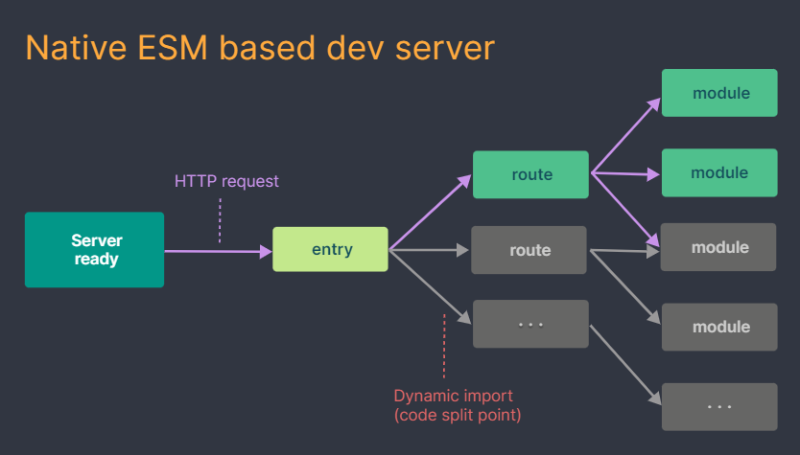
Vite?
Vite, pronounced /vit/ - French word for "quick“
A build tool provides a faster and leaner development experience
Vite divides the modules in an application into two categories: dependencies and source code
Vite pre-bundles dependencies using esbuild (written in Go, 10-100x faster than JS-based bundlers)
Vite serves source code over native ESM (forego the bundling step because it serves the browser native ES modules)

Slide 6

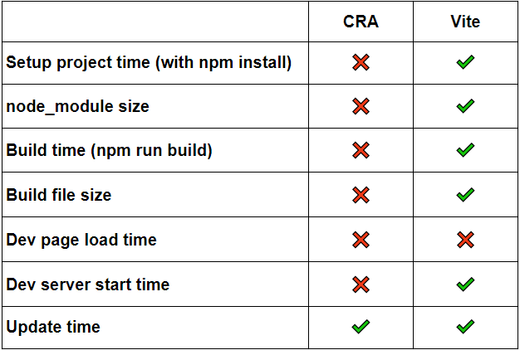
Why Vite?
Fast Build Time
Fast Dev Server Start Time
Same first load time (vs CRA)
Process the “Hot Module Replacement" feature as well (vs CRA)
Clear documentation

Slide 7
EditorConfig, Prettier, Eslint

Slide 8
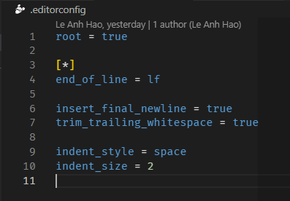
EditorConfig
Maintains consistent coding styles
Defines a standard code formatting style guide
Easy to use and clear documentation

Slide 9
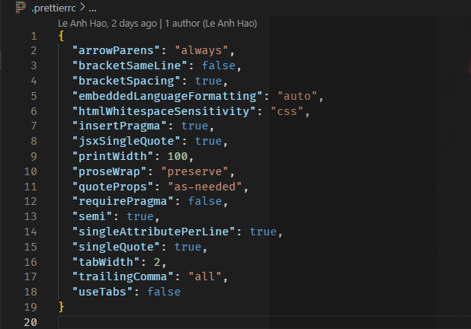
Prettier
An opinionated code formatter
Ensures code conforms to a consistent style
Care only Formatting rules
Easy to config and clear documentation

Slide 10
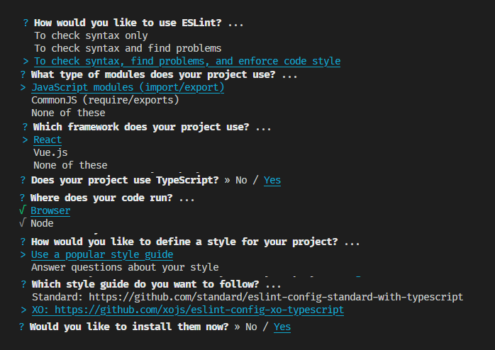
Eslint
A linter comes with a setup tool
Care about Formatting rules and about Code-quality rules
Many plugins, popular templates
- Good documentation but too lengthy

Slide 11
Eslint
A linter comes with a setup tool
Care about Formatting rules and about Code-quality rules
Many plugins, popular templates
- Good documentation but too lengthy

Slide 12
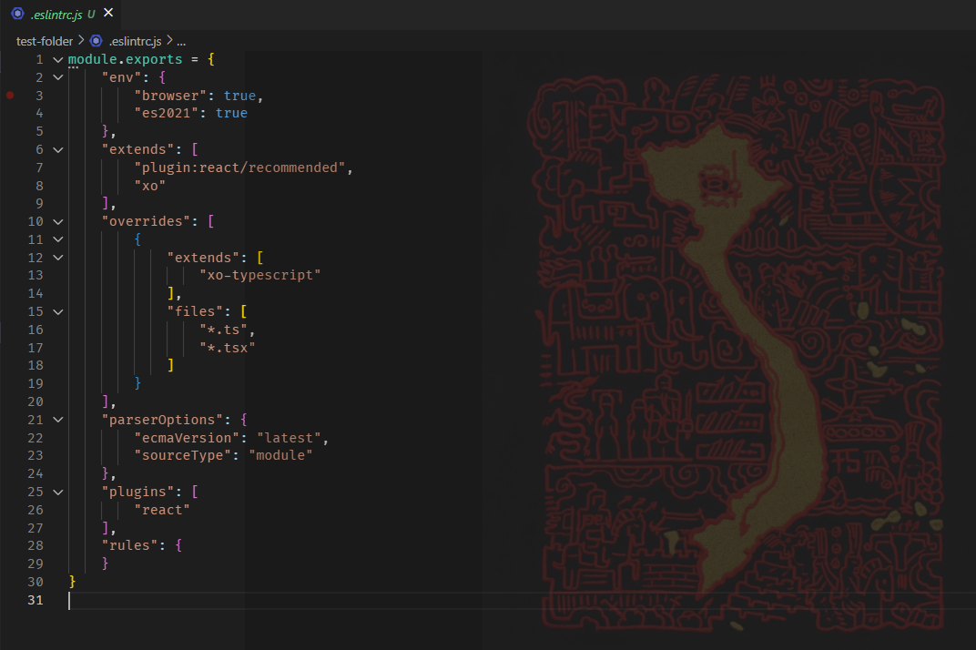
Eslint initial config file

Slide 13

Conflict, Why?

Slide 14

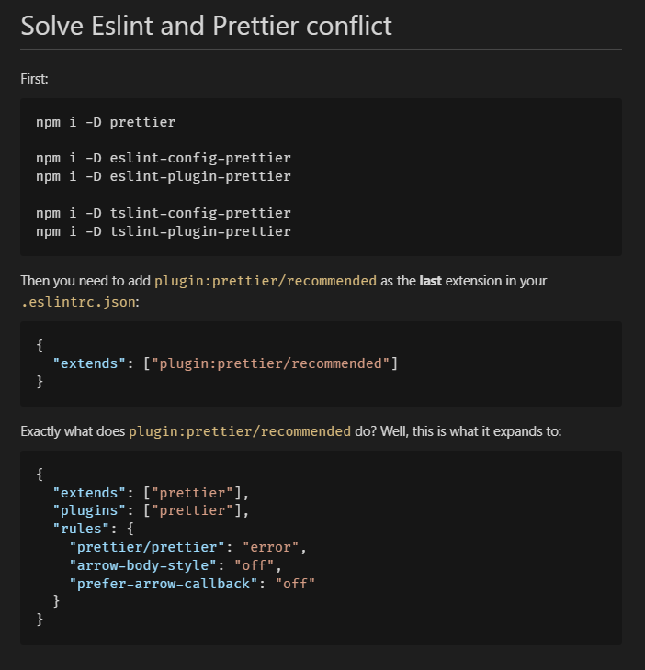
How to solve conflict?
Disable all Formatting rules of Eslint
Let Prettier do its duty
Eslint should only focus on Code-quality rules

Slide 15
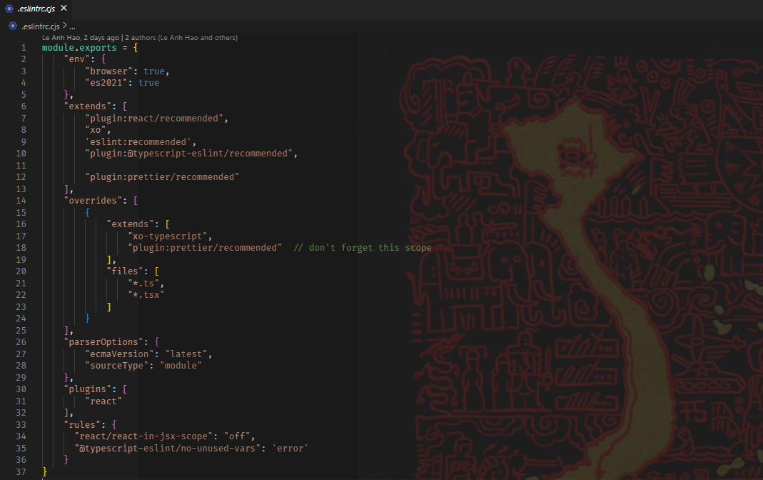
Eslint config file

Slide 16
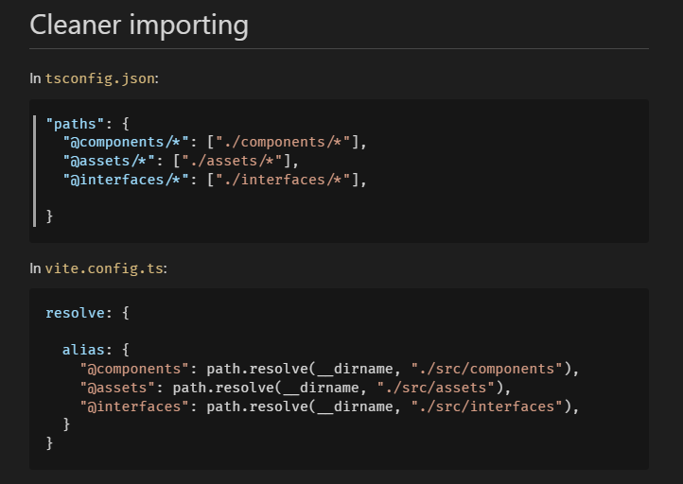


Configure cleaner importing
Sometimes we face this problem
In larger projects, this could be a nightmare
To solve that problem, we use absolute import and alias

Slide 17
A Cool VSCode Ext?
Extension name: In Your Face
Transform the problems to memes
Useless, but it’s fun =)))

Slide 18
Story books?
Pls read its documentations ☺ Note:
Hot Reload not work with JsDocs (Props description)
To put all variant component in the same folder with the primary (set same title)

Slide 19
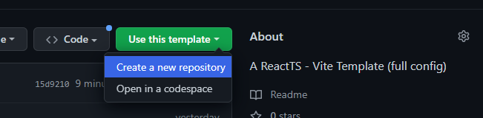

Template
Repo: https://github.com/haola1210/react-ts-vite-template
Pls read the README carefully
Please just copy the main branch (un-check this)

Slide 20
Thank you
Hao Le
haola1210@gmail.com

